Slide 1
Progressive Game Engines Assignment Name
By James Tebbutt, Jack Halst, Ben Brandwood-Ward

Slide 2
Mechanics implemented
General Movement
Crouch
Walk
Sprint
Enemies
Procedural Environments and Levels
Generated using Walker Method. More on that on coming slides
Win/Loss States
Level Complete when all enemies killed
Game over when health = 0

Slide 3
Walker Method
Starts by spawning a single room. This would be our start room.
From there, there are four potential locations that a room can be generated. When the room is generated, it is set to the current room and the process continues until is has created the required number of room. E.g. 100 rooms.
This method also uses backtracking to allow for multiple paths to lead to the same location.

Slide 4
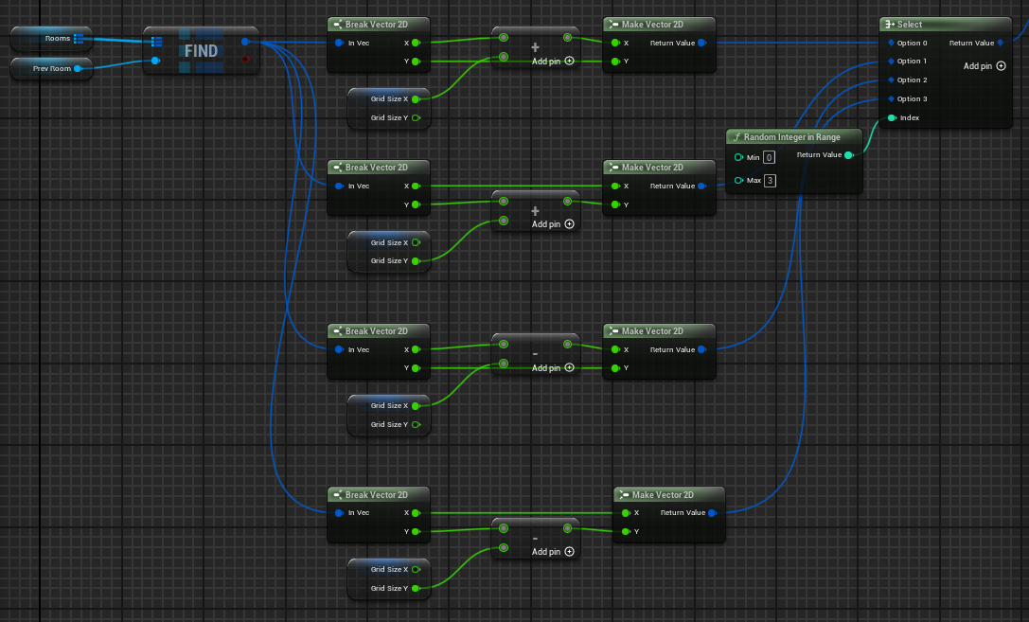
Walker Method Cont’d
Randomly selects one of the for potential locations.
Create room to the right of current room.
Create room at top of current room.
Create room to the left of current room.
Create room at bottom of current room.

Slide 5
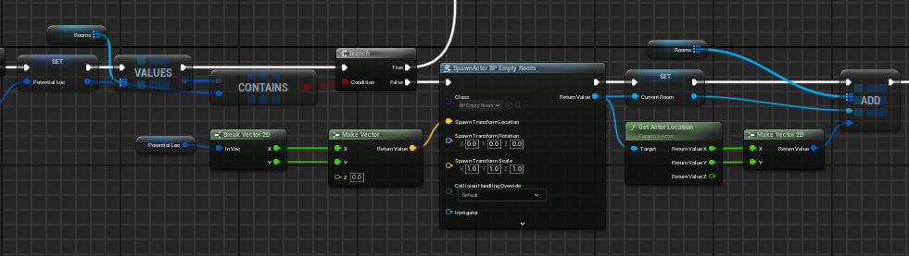
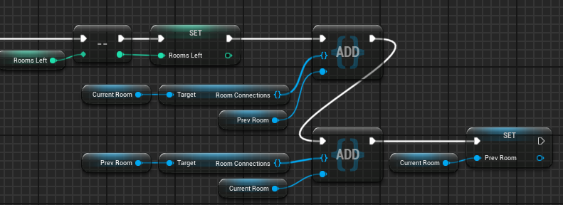
Sets the selected room location as the potential location and checks if it is already in the blueprint map library.
If false, spawn the room at the decided location, set it to the current room and add it to the blueprint map library for rooms.
Adds the current room and previous room to the room connections array. This is used when the paths are created once all the rooms were generated

Slide 6
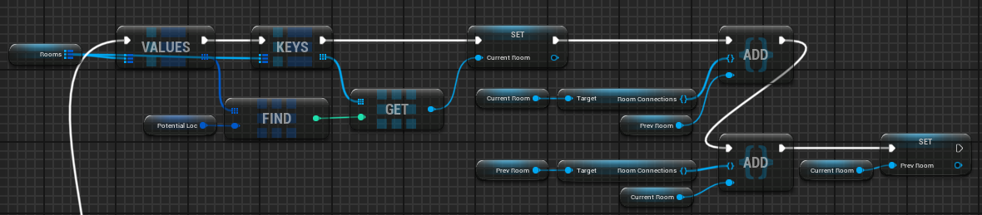
If the potential location already exists in the blueprint map library, find the value of the first instance of the potential location and get its key before setting it as the current room and adding it to the room connections array for use later.

Slide 7
HUD
Basic HUD, displaying ammo, mags, health and score

Slide 8
HUD Cont’d

Slide 10
NPC
The only type of NPCs added were enemies. There were plans for a shop where you could buy upgrades and items but we ended up cutting it to reduce scope and meet the deadline.
Enemies controlled using behaviour tree, switching between patrol, chase, and attack when the parameters had been met.

Slide 11
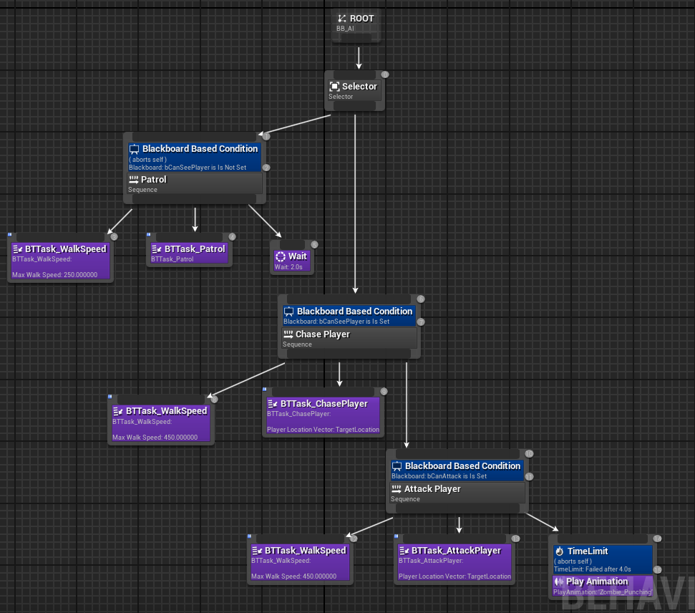
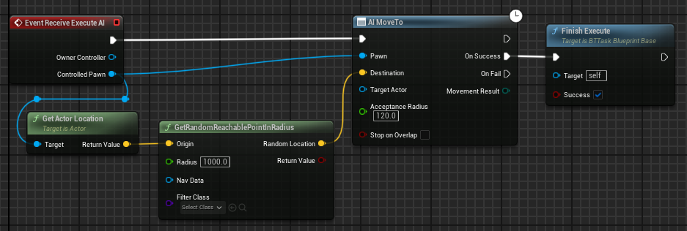
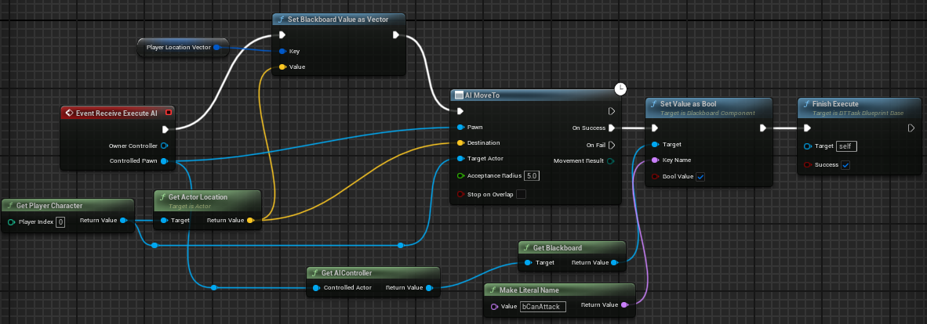
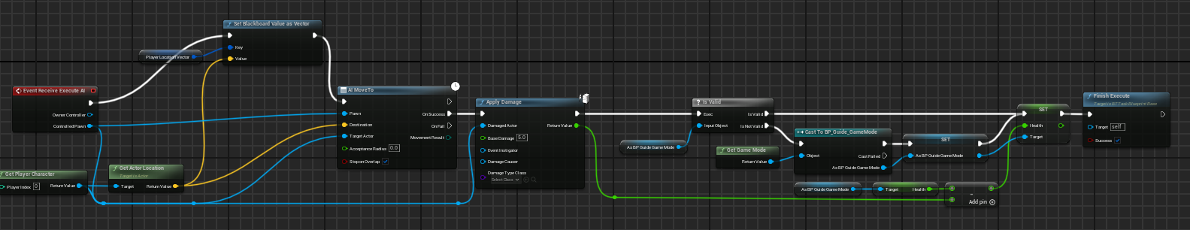

Slide 13
Menu Systems
Several Menus made; Pause, Main, Credits, Settings, Save/Load
Making flagrant use of background blur, boxes to keep the buttons in line
Save and Load system took a while, saves level now, want to adapt to save player variables between levels
Settings includes; Audio sliders, difficulty drop down and a controls toggle

Slide 14
Challenges

Slide 15
References

